Slide 1



Identifying Similar-Bicliques in Bipartite Graphs
Kai Yao
The University of Sydney
kyao8420@uni.sydney.edu.au
Lijun Chang
The University of Sydney
lijun.chang@sydney.edu.au
Jeffrey Xu Yu
The Chinese University of Hong Kong
yu@se.cuhk.edu.hk

Slide 2
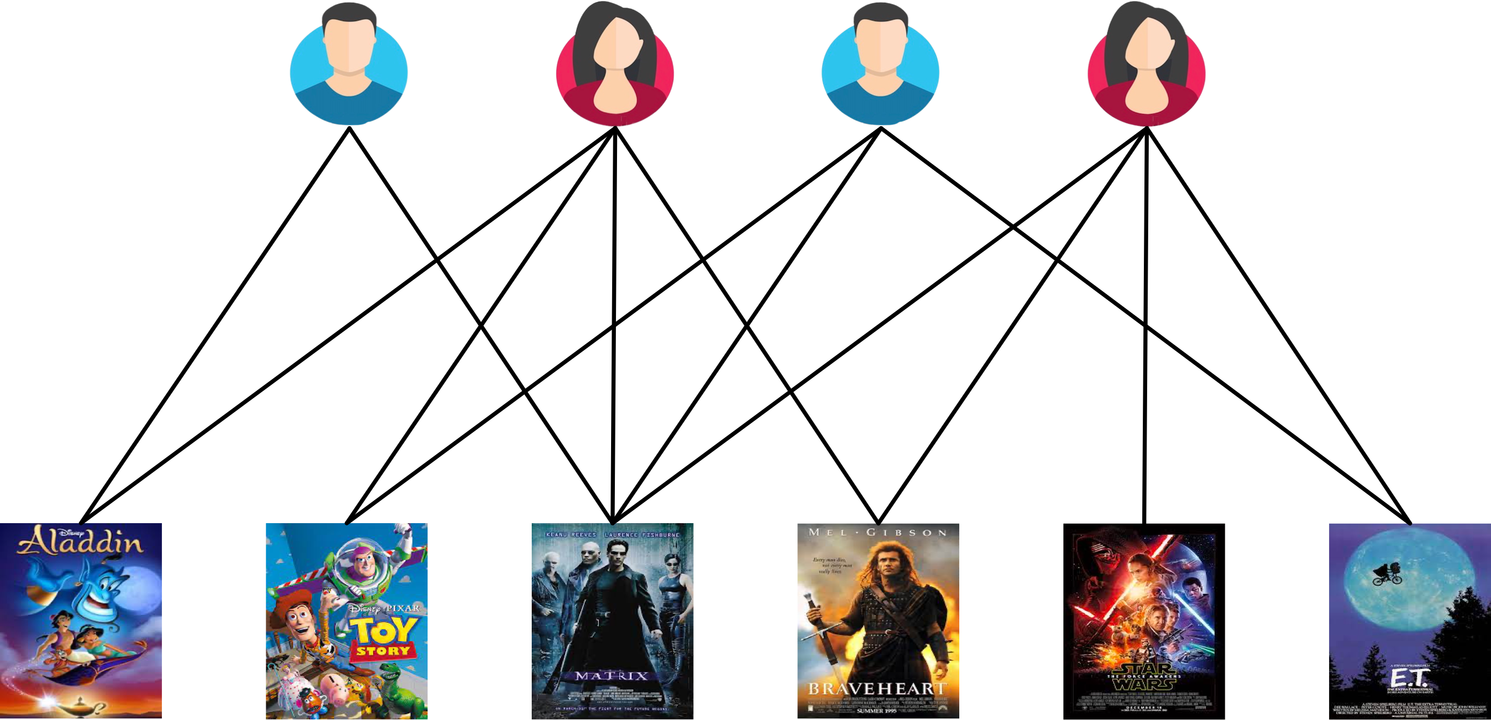
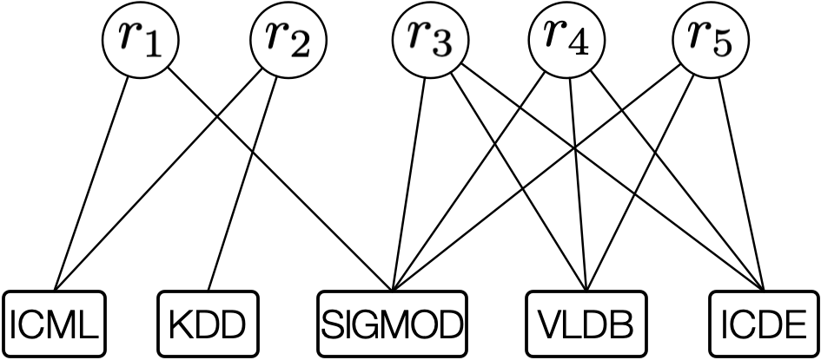
Introduction
Bipartite graphs capture relationships between two types of entities.
User-movie
Researcher-venue
Customer-product
…
User-movie bipartite graph
Researcher-venue bipartite graph

Slide 3
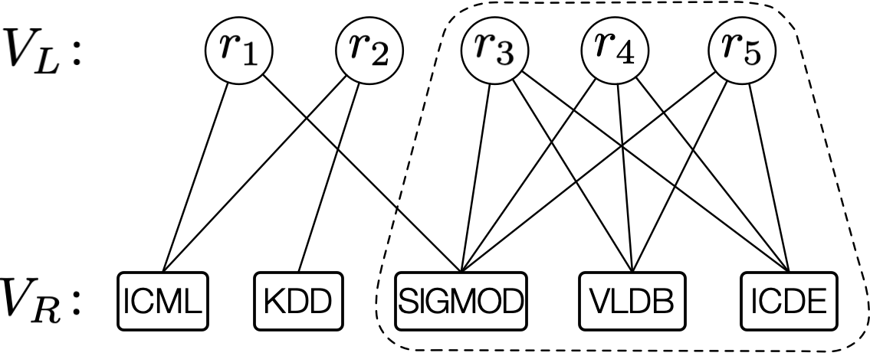
Introduction
Finding dense subgraphs in a bipartite graph is of great significance.
Applications: community detection, anomaly detection, and so on.
One classic notion of dense bipartite subgraph is biclique.
Existing studies focus on biclique detection
Maximal biclique enumeration
Maximum biclique detection
The biclique model may be unsuitable for some cases.
a biclique
Researcher-venue bipartite graph

Slide 4
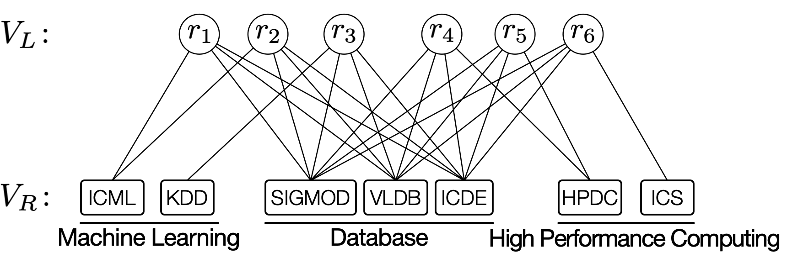
Limitations of the biclique model
Vertices in a biclique are not necessarily similar to each other, despite that they share a set of common neighbors.
Researcher-venue bipartite graph

Slide 5
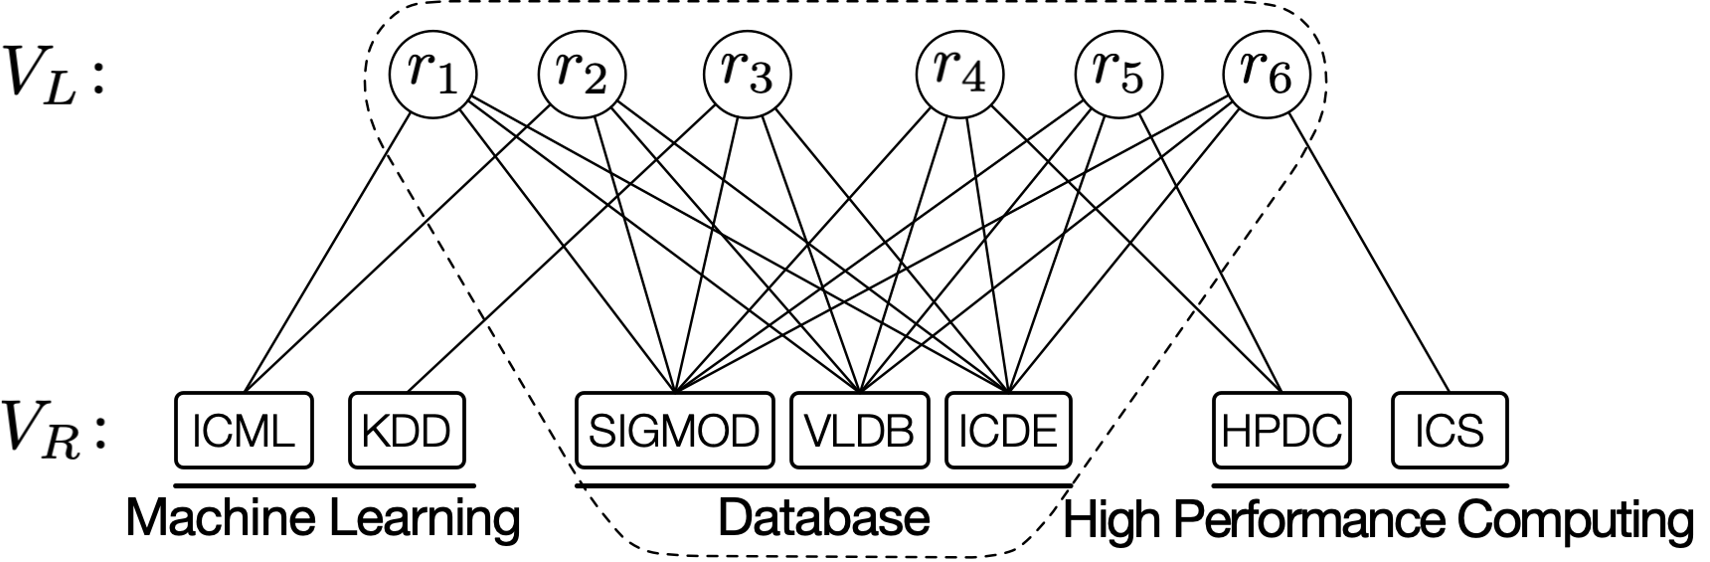
Limitations of the biclique model
Vertices in a biclique are not necessarily similar to each other, despite that they share a set of common neighbors.
Researcher-venue bipartite graph

Slide 6
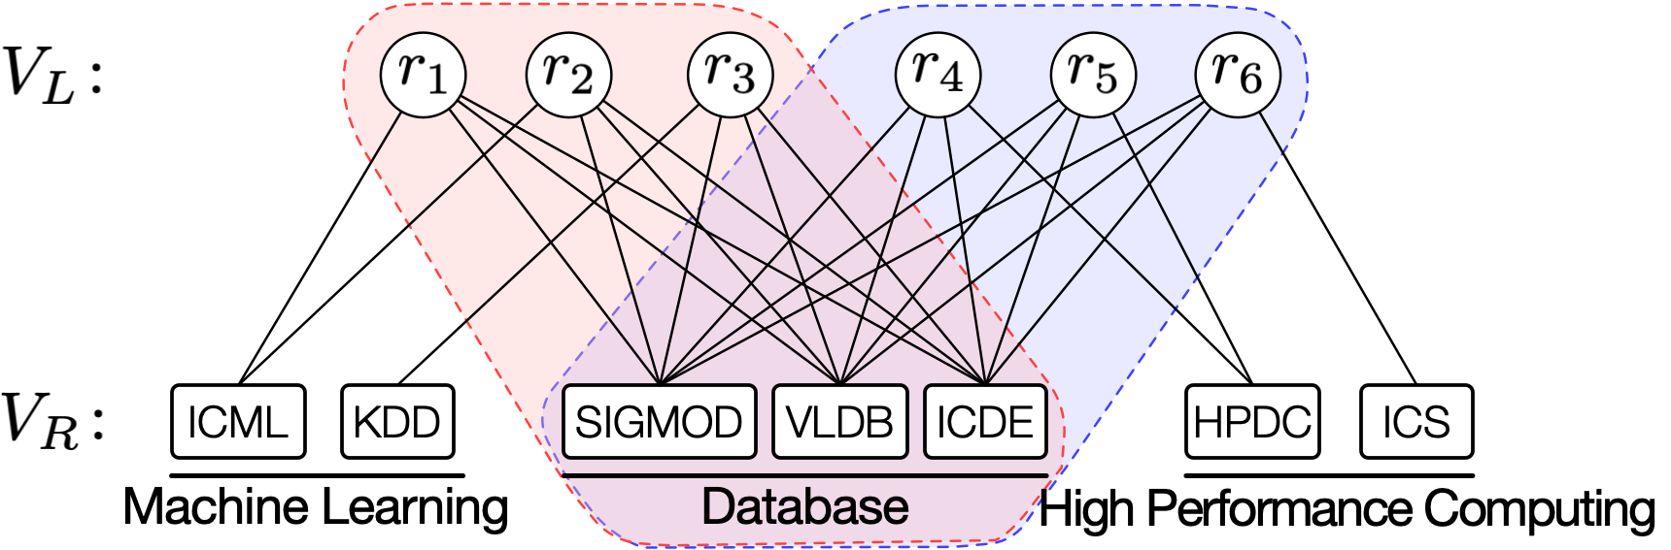
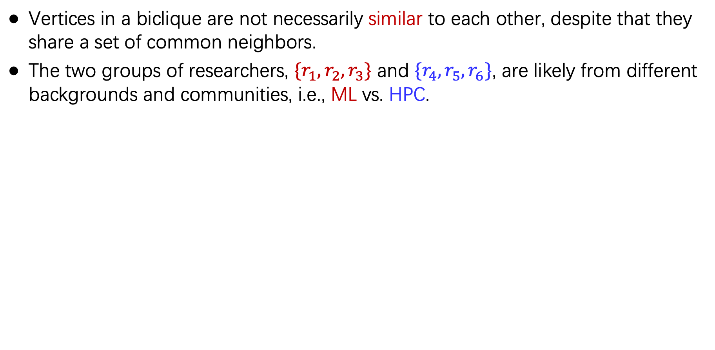
Limitations of the biclique model
Vertices in a biclique are not necessarily similar to each other, despite that they share a set of common neighbors.
The two groups of researchers, $\{r_{1},r_{2},r_{3}\}$ and $\{r_{4},r_{5},r_{6}\}$, are likely from different backgrounds and communities, i.e., ML vs. HPC.
Researcher-venue bipartite graph

Slide 7
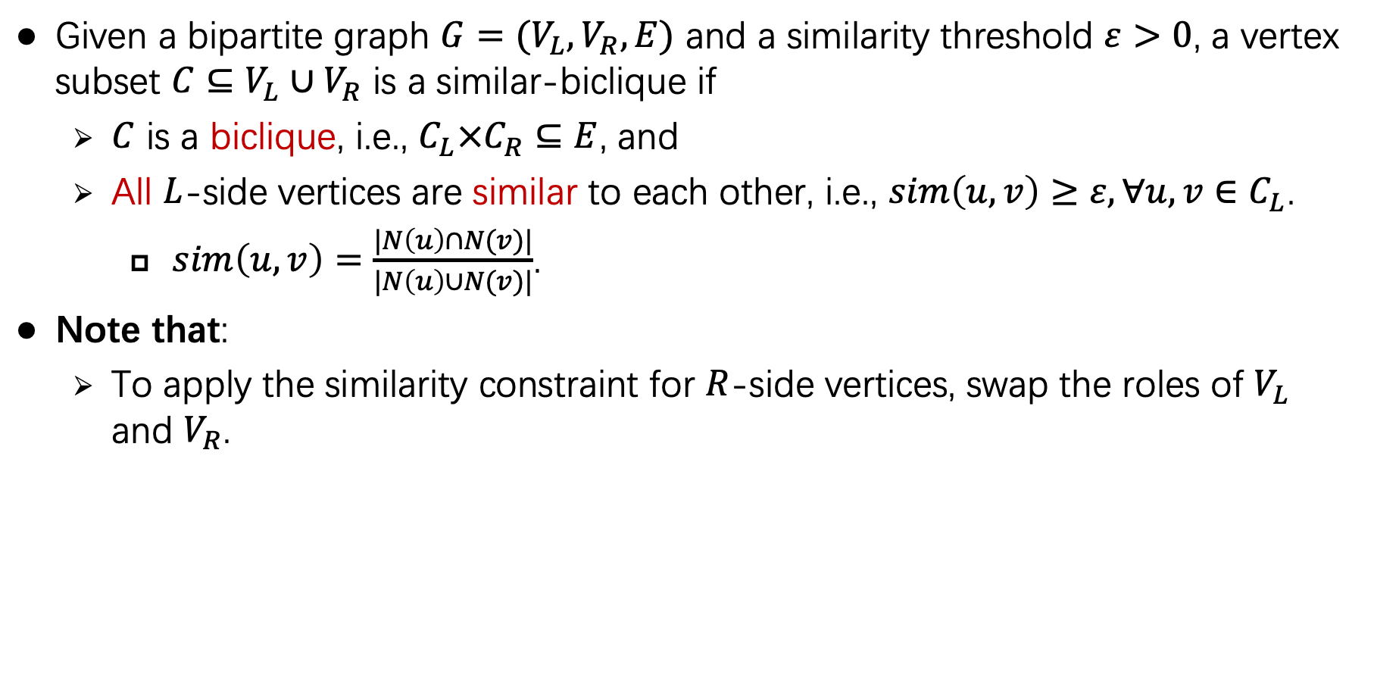
Similar-biclique
Given a bipartite graph $G=(V_{L},V_{R},E)$ and a similarity threshold $ε>0$, a vertex subset $C⊆V_{L}∪V_{R}$ is a similar-biclique if
$C$ is a biclique, i.e., $C_{L}×C_{R}⊆E$, and
All $L$-side vertices are similar to each other, i.e., $sim\left(u,v\right)≥ε, ∀u,v∈C_{L}$.
$sim\left(u,v\right)=\frac{|N\left(u\right)∩N(v)|}{|N\left(u\right)∪N(v)|}$.
Note that:
To apply the similarity constraint for $R$-side vertices, swap the roles of $V_{L}$ and $V_{R}$.

Slide 8
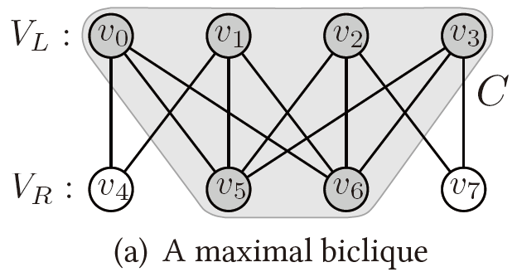
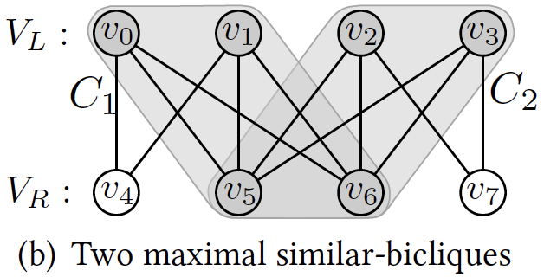
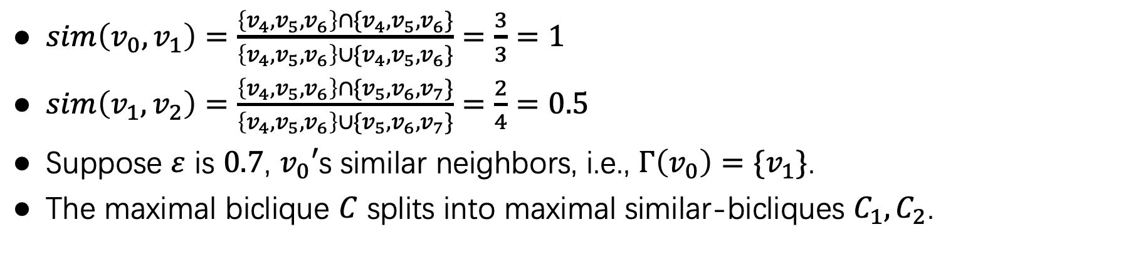
Maximal biclique vs. maximal similar-biclique
$sim\left(v_{0},v_{1}\right)=\frac{\left\{v_{4},v_{5},v_{6}\right\}∩\{v_{4},v_{5},v_{6}\}}{\left\{v_{4},v_{5},v_{6}\right\}∪\{v_{4},v_{5},v_{6}\}}=\frac{3}{3}=1$
$sim\left(v_{1},v_{2}\right)=\frac{\left\{v_{4},v_{5},v_{6}\right\}∩\{v_{5},v_{6},v_{7}\}}{\left\{v_{4},v_{5},v_{6}\right\}∪\{v_{5},v_{6},v_{7}\}}=\frac{2}{4}=0.5$
Suppose $ε$ is $0.7$, $v_{0}′$s similar neighbors, i.e., $Γ\left(v_{0}\right)=\{v_{1}\}$.
The maximal biclique $C$ splits into maximal similar-bicliques $C_{1}, C_{2}$.
A maximal biclique
Two maximal similar-bicliques

Slide 9
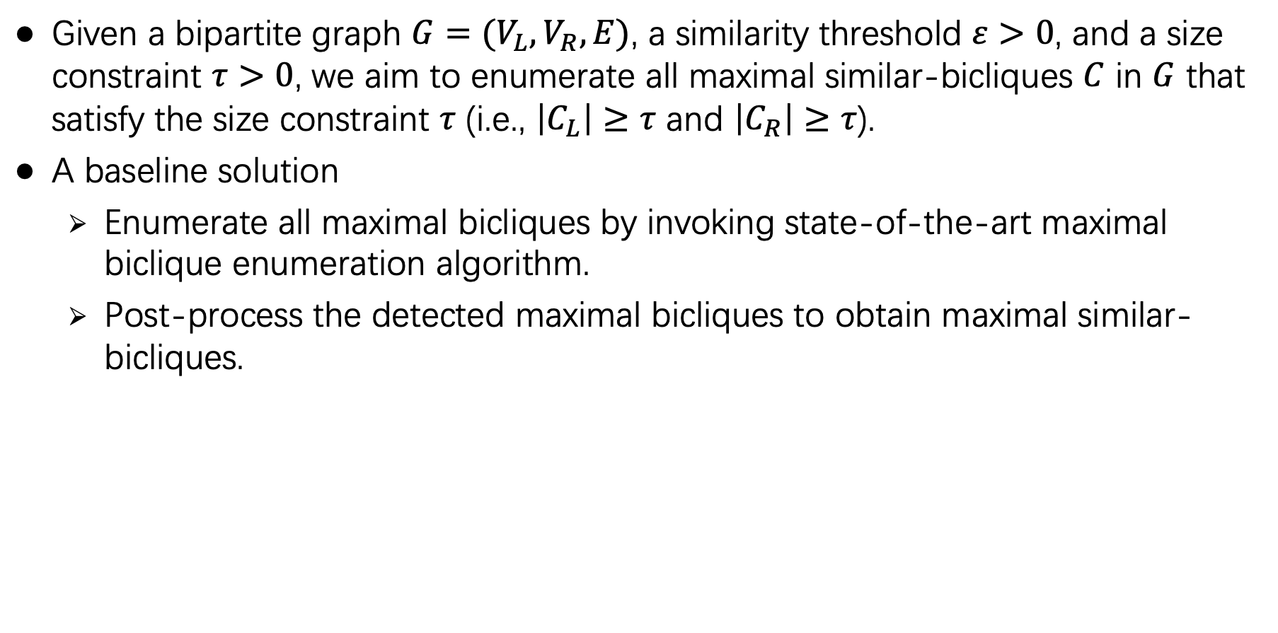
Problem statement
Given a bipartite graph $G=(V_{L},V_{R},E)$, a similarity threshold $ε>0$, and a size constraint $τ>0$, we aim to enumerate all maximal similar-bicliques $C$ in $G$ that satisfy the size constraint $τ$ (i.e., $\left|C_{L}\right|≥τ$ and $\left|C_{R}\right|≥τ$).
A baseline solution
Enumerate all maximal bicliques by invoking state-of-the-art maximal biclique enumeration algorithm.
Post-process the detected maximal bicliques to obtain maximal similar-bicliques.

Slide 10
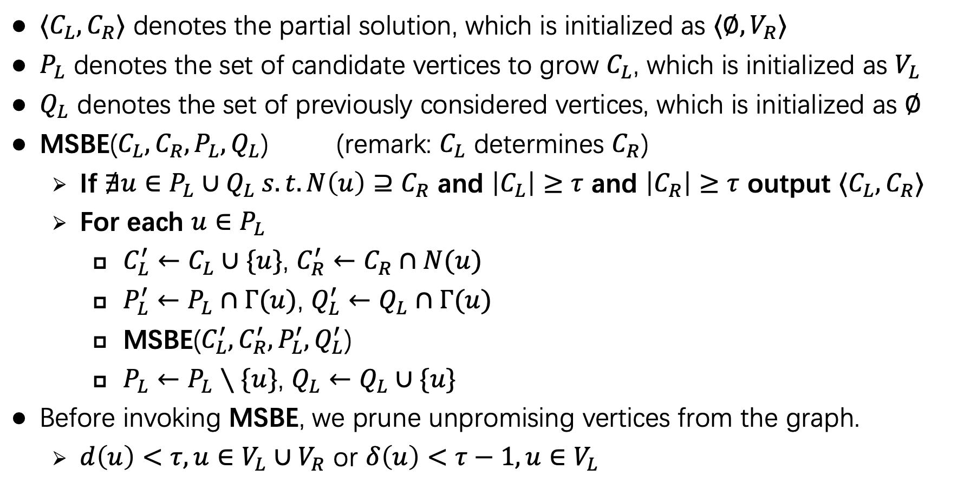
Our MSBE algorithm
$⟨C_{L},C_{R}⟩$ denotes the partial solution, which is initialized as $⟨∅,V_{R}⟩$
$P_{L}$ denotes the set of candidate vertices to grow $C_{L}$, which is initialized as $V_{L}$
$Q_{L}$ denotes the set of previously considered vertices, which is initialized as $∅$
MSBE($C_{L},C_{R},P_{L},Q_{L}$) (remark: $C_{L}$ determines $C_{R}$)
If $∄u∈P_{L}∪Q_{L} s.t. N\left(u\right)⊇C_{R}$ and $\left|C_{L}\right|≥τ$ and $\left|C_{R}\right|≥τ$ output $⟨C_{L},C_{R}⟩$
For each $u∈P_{L}$
$C_{L}^{′}←C_{L}∪\{u\}$, $C_{R}^{′}←C_{R}∩N(u)$
$P_{L}^{′}←P_{L}∩Γ(u)$, $Q_{L}^{′}←Q_{L}∩Γ(u)$
MSBE($C_{L}^{′},C_{R}^{′},P_{L}^{′},Q_{L}^{′}$)
$P_{L}←P_{L}∖\{u\}$, $Q_{L}←Q_{L}∪\{u\}$
Before invoking MSBE, we prune unpromising vertices from the graph.
$d\left(u\right)<τ, u∈V_{L}∪V_{R}$ or $δ\left(u\right)<τ−1, u∈V_{L}$

Slide 11
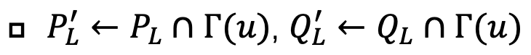
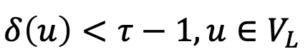
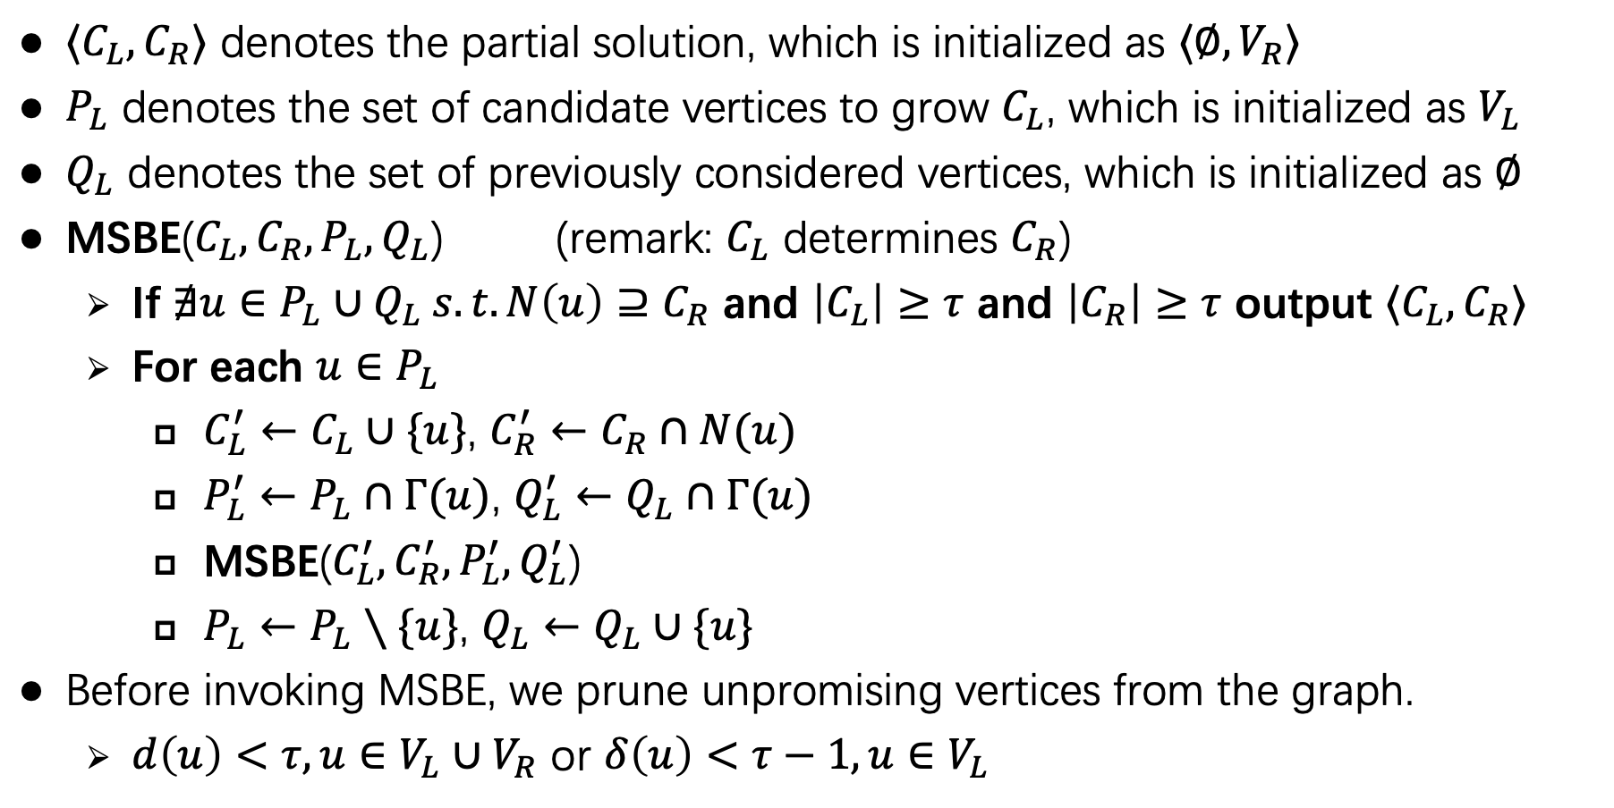
Our MSBE algorithm
$⟨C_{L},C_{R}⟩$ denotes the partial solution, which is initialized as $⟨∅,V_{R}⟩$
$P_{L}$ denotes the set of candidate vertices to grow $C_{L}$, which is initialized as $V_{L}$
$Q_{L}$ denotes the set of previously considered vertices, which is initialized as $∅$
MSBE($C_{L},C_{R},P_{L},Q_{L}$) (remark: $C_{L}$ determines $C_{R}$)
If $∄u∈P_{L}∪Q_{L} s.t. N\left(u\right)⊇C_{R}$ and $\left|C_{L}\right|≥τ$ and $\left|C_{R}\right|≥τ$ output $⟨C_{L},C_{R}⟩$
For each $u∈P_{L}$
$C_{L}^{′}←C_{L}∪\{u\}$, $C_{R}^{′}←C_{R}∩N(u)$
$P_{L}^{′}←P_{L}∩Γ(u)$, $Q_{L}^{′}←Q_{L}∩Γ(u)$
MSBE($C_{L}^{′},C_{R}^{′},P_{L}^{′},Q_{L}^{′}$)
$P_{L}←P_{L}∖\{u\}$, $Q_{L}←Q_{L}∪\{u\}$
Before invoking MSBE, we prune unpromising vertices from the graph.
$d\left(u\right)<τ, u∈V_{L}∪V_{R}$ or $δ\left(u\right)<τ−1, u∈V_{L}$
Similar neighbors computation is time-consuming

Slide 12
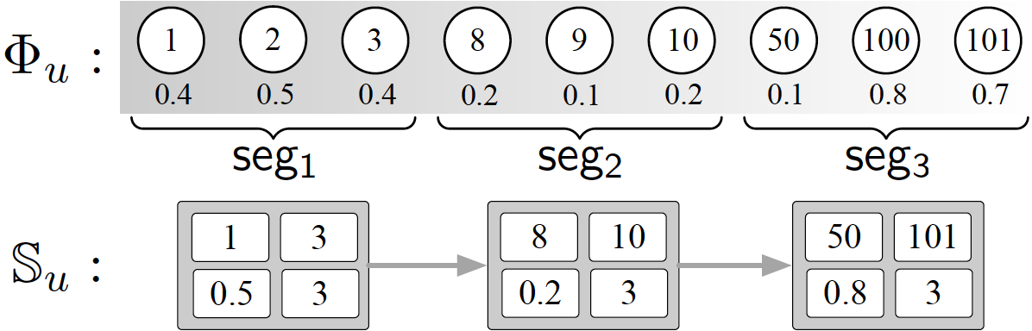
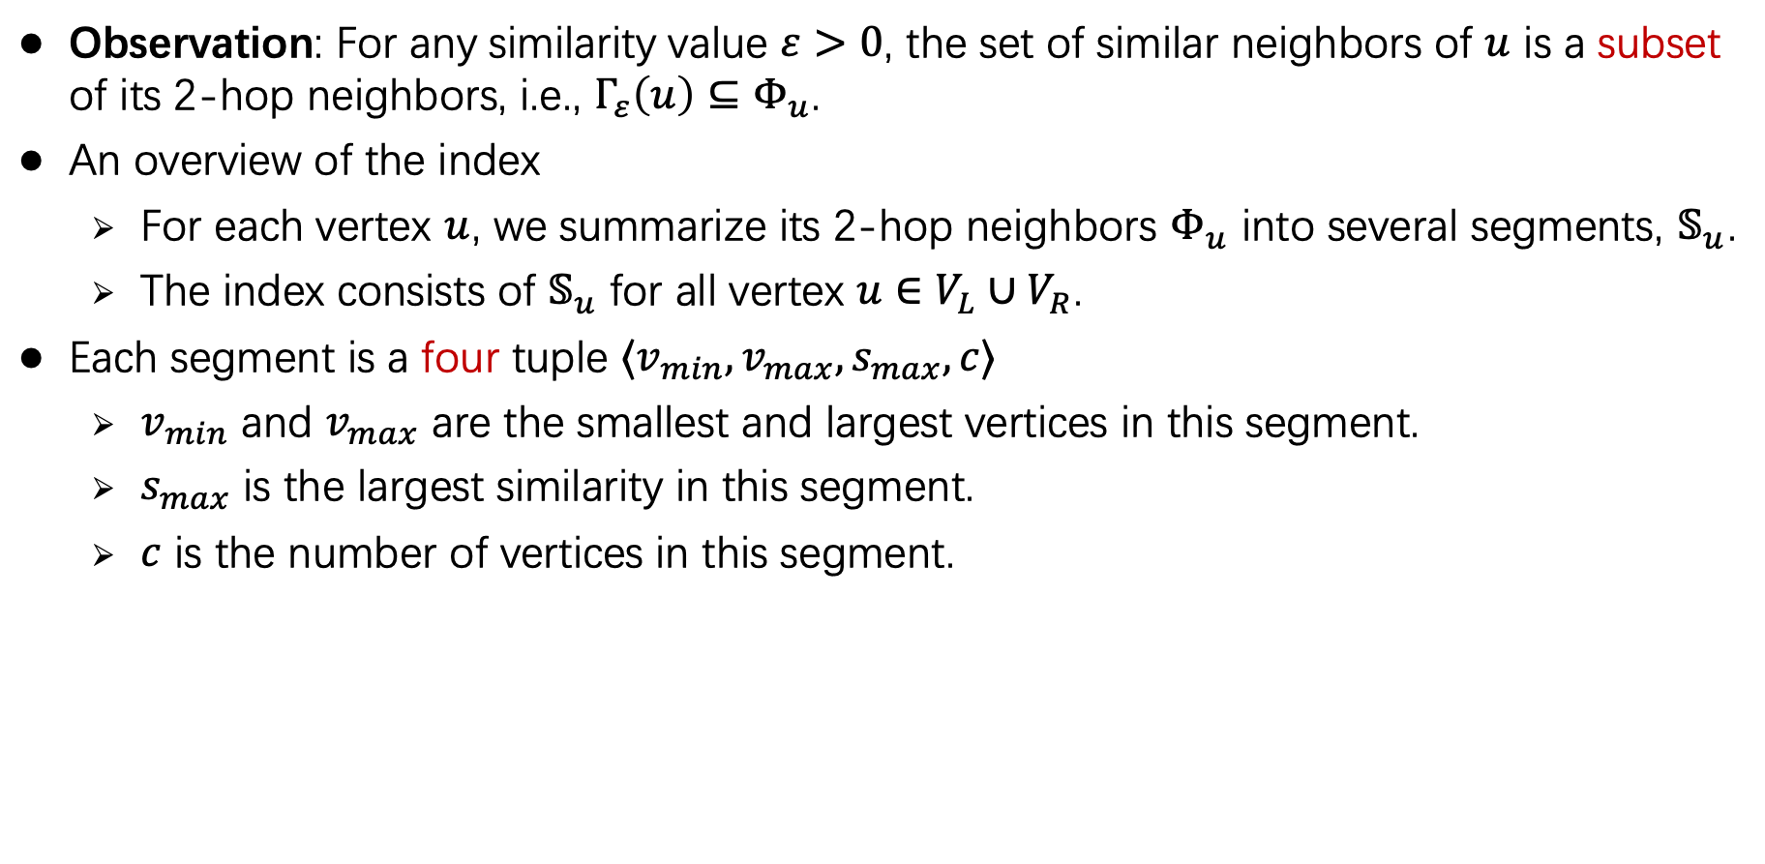
Index-based similar neighbors computation
Observation: For any similarity value $ε>0$, the set of similar neighbors of $u$ is a subset of its 2-hop neighbors, i.e., $Γ_{ε}\left(u\right)⊆Φ_{u}$.
An overview of the index
For each vertex $u$, we summarize its 2-hop neighbors $Φ_{u}$ into several segments, $𝕊_{u}$.
The index consists of $𝕊_{u}$ for all vertex $u∈V_{L}∪V_{R}$.
Each segment is a four tuple $⟨v_{min},v_{max},s_{max},c⟩$
$v_{min}$ and $v_{max}$ are the smallest and largest vertices in this segment.
$s_{max}$ is the largest similarity in this segment.
$c$ is the number of vertices in this segment.

Slide 13
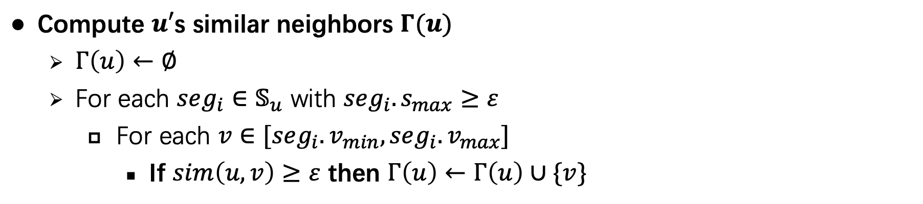
Index-based similar neighbors computation
Compute $u′$s similar neighbors $Γ(u)$
$Γ\left(u\right)←∅$
For each $seg_{i}∈𝕊_{u}$ with $seg_{i}.s_{max}≥ε$
For each $v∈[seg_{i}.v_{min},seg_{i}.v_{max}]$
If $sim\left(u,v\right)≥ε$ then $Γ\left(u\right)←Γ\left(u\right)∪\{v\}$

Slide 14
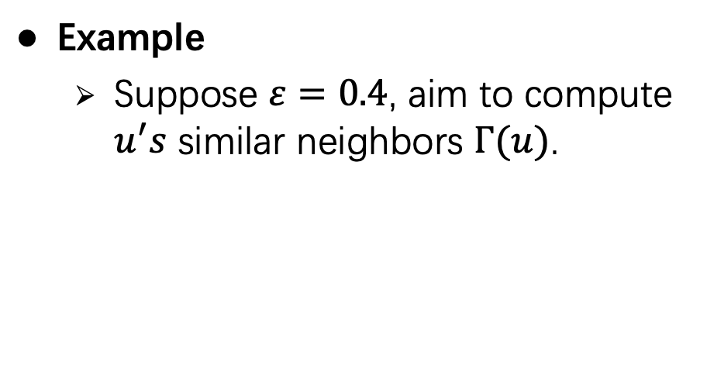
Index-based similar neighbors computation
Compute $u′$s similar neighbors $Γ(u)$
$Γ\left(u\right)←∅$
For each $seg_{i}∈𝕊_{u}$ with $seg_{i}.s_{max}≥ε$
For each $v∈[seg_{i}.v_{min},seg_{i}.v_{max}]$
If $sim\left(u,v\right)≥ε$ then $Γ\left(u\right)←Γ\left(u\right)∪\{v\}$
Example
Suppose $ε=0.4$, aim to compute $u^{′}s$ similar neighbors $Γ(u)$.

Slide 15
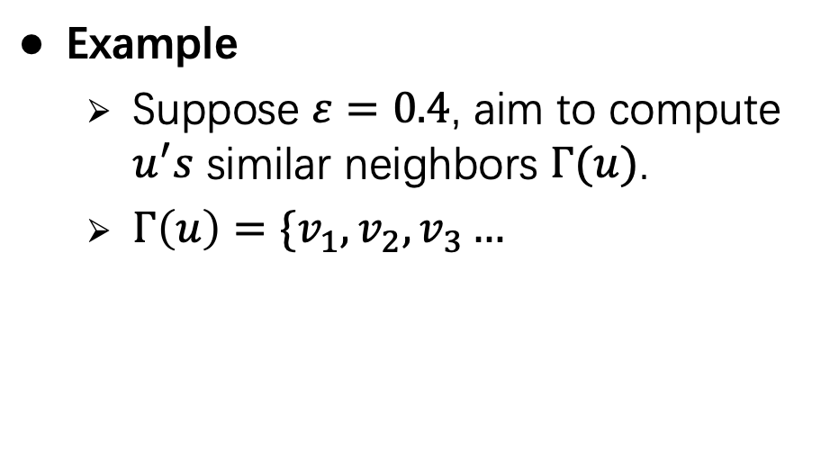
Index-based similar neighbors computation
Compute $u′$s similar neighbors $Γ(u)$
$Γ\left(u\right)←∅$
For each $seg_{i}∈𝕊_{u}$ with $seg_{i}.s_{max}≥ε$
For each $v∈[seg_{i}.v_{min},seg_{i}.v_{max}]$
If $sim\left(u,v\right)≥ε$ then $Γ\left(u\right)←Γ\left(u\right)∪\{v\}$
Example
Suppose $ε=0.4$, aim to compute $u^{′}s$ similar neighbors $Γ(u)$.
$Γ\left(u\right)=\{v_{1},v_{2},v_{3}…$

Slide 16
Index-based similar neighbors computation
Compute $u′$s similar neighbors $Γ(u)$
$Γ\left(u\right)←∅$
For each $seg_{i}∈𝕊_{u}$ with $seg_{i}.s_{max}≥ε$
For each $v∈[seg_{i}.v_{min},seg_{i}.v_{max}]$
If $sim\left(u,v\right)≥ε$ then $Γ\left(u\right)←Γ\left(u\right)∪\{v\}$
Example
Suppose $ε=0.4$, aim to compute $u^{′}s$ similar neighbors $Γ(u)$.
$Γ\left(u\right)=\{v_{1},v_{2},v_{3}…$

Slide 17
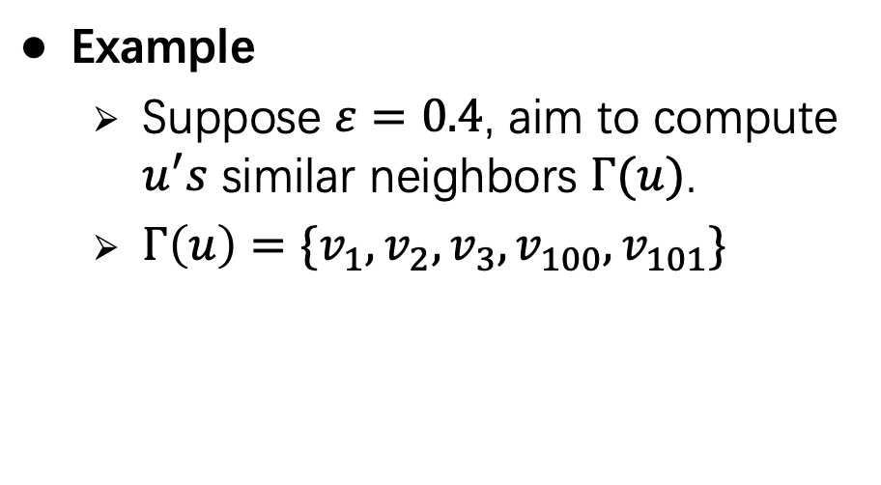
Index-based similar neighbors computation
Compute $u′$s similar neighbors $Γ(u)$
$Γ\left(u\right)←∅$
For each $seg_{i}∈𝕊_{u}$ with $seg_{i}.s_{max}≥ε$
For each $v∈[seg_{i}.v_{min},seg_{i}.v_{max}]$
If $sim\left(u,v\right)≥ε$ then $Γ\left(u\right)←Γ\left(u\right)∪\{v\}$
Example
Suppose $ε=0.4$, aim to compute $u^{′}s$ similar neighbors $Γ(u)$.
$Γ\left(u\right)=\{v_{1},v_{2},v_{3},v_{100},v_{101}\}$

Slide 18
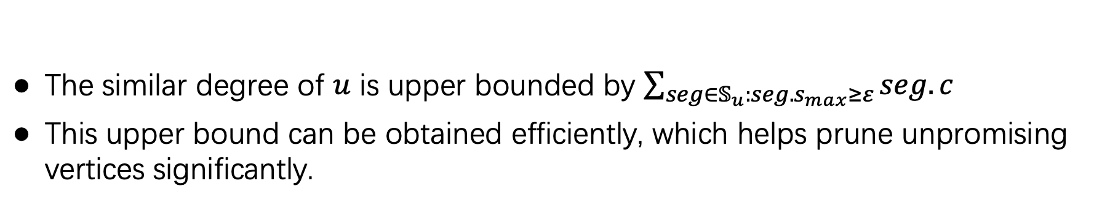
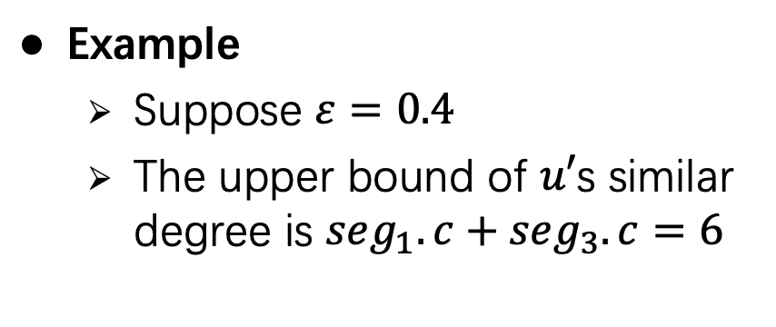
Upper bound of similar degree
The similar degree of $u$ is upper bounded by $\sum_{seg∈𝕊_{u}:seg.s_{max}≥ε}{seg.c}$
This upper bound can be obtained efficiently, which helps prune unpromising vertices significantly.
Example
Suppose $ε=0.4$
The upper bound of $u′$s similar degree is $seg_{1}.c+seg_{3}.c=6$

Slide 19
Other techniques
A two-phase algorithm for efficient vertex reduction
Phase-I: based on structural degree and upper bound of similar degree
Phase-II: based on structural degree and similar degree
Different strategies to construct the index
Largest gap (LG) strategy
Steady segment (SS) strategy
Optimization techniques to facilitate enumeration procedure
Refer to the paper for details

Slide 20
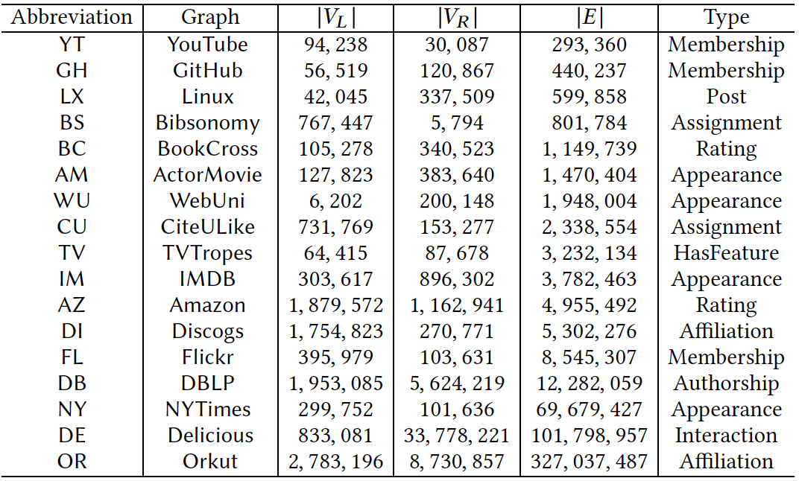
Experiments
Platform: Intel Core-i7 3.20GHz CPU, 64GB memory.
Datasets:

Slide 21
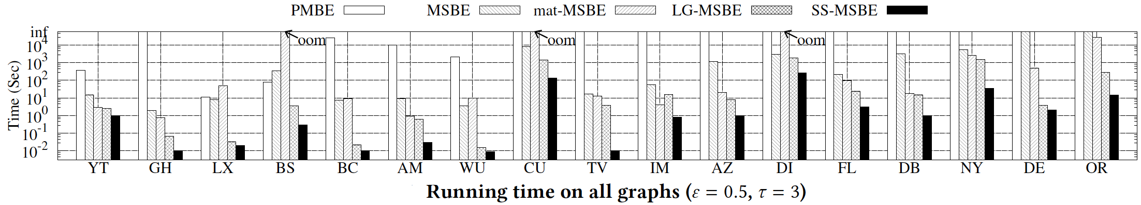
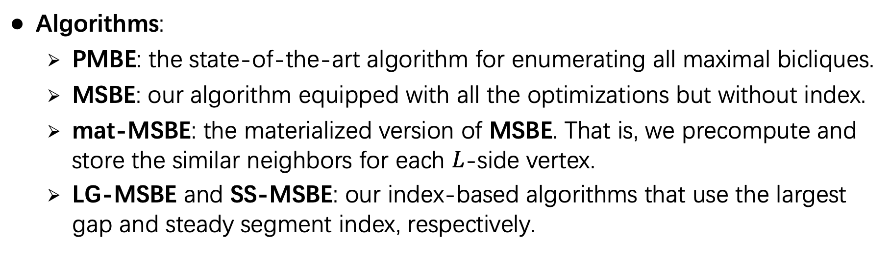
Efficiency evaluation
Algorithms:
PMBE: the state-of-the-art algorithm for enumerating all maximal bicliques.
MSBE: our algorithm equipped with all the optimizations but without index.
mat-MSBE: the materialized version of MSBE. That is, we precompute and store the similar neighbors for each $L$-side vertex.
LG-MSBE and SS-MSBE: our index-based algorithms that use the largest gap and steady segment index, respectively.

Slide 22
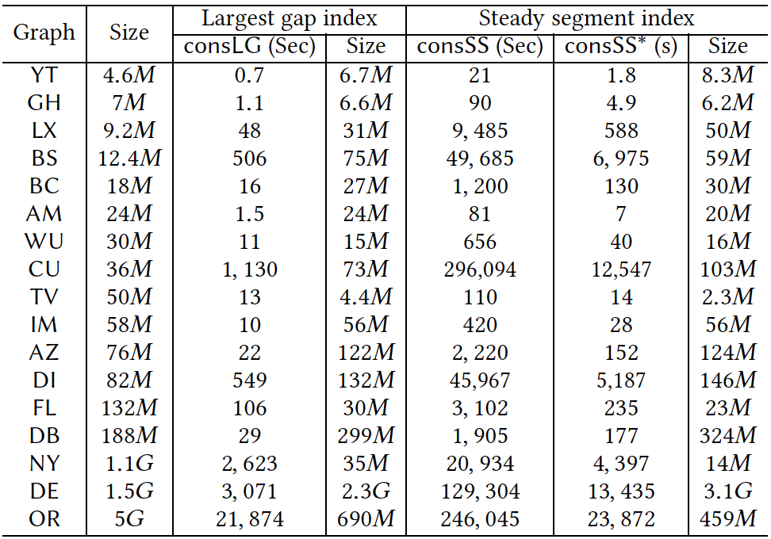
Index size and construction time

Slide 23
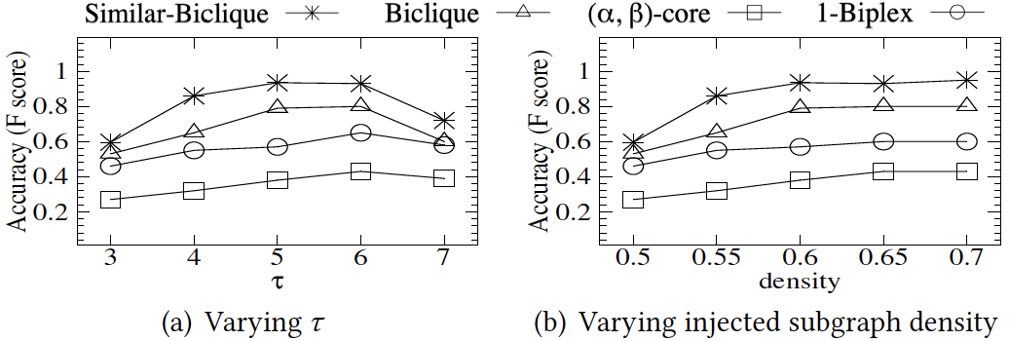
Case study: anomaly detection

Slide 24
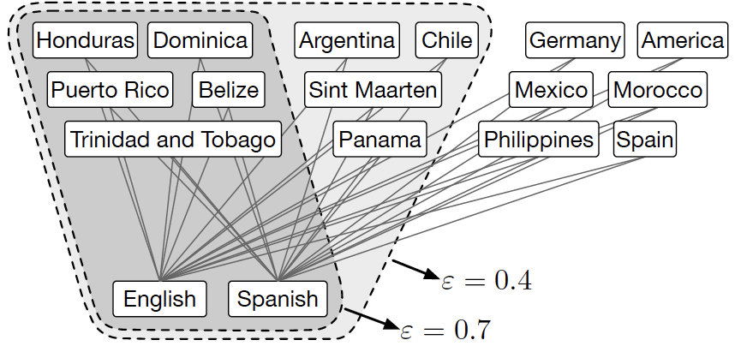
Case study: similar-bicliques in Unicode (𝜏 = 2)

Slide 25
Conclusion
We formulate the concept of similar-biclique.
We develop a backtracking algorithm MSBE.
We design a novel index structure to facilitate the similar neighbors computation.
We propose effective and efficient index construction algorithms.

Slide 26
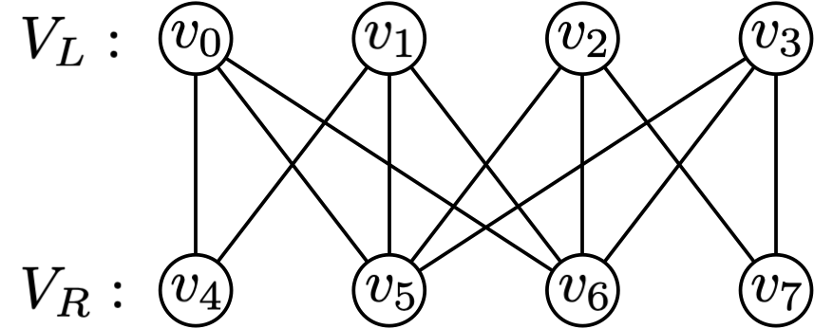
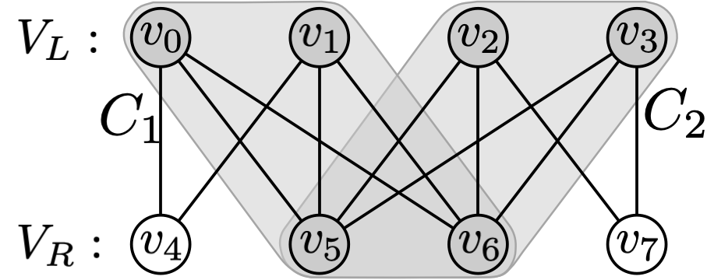
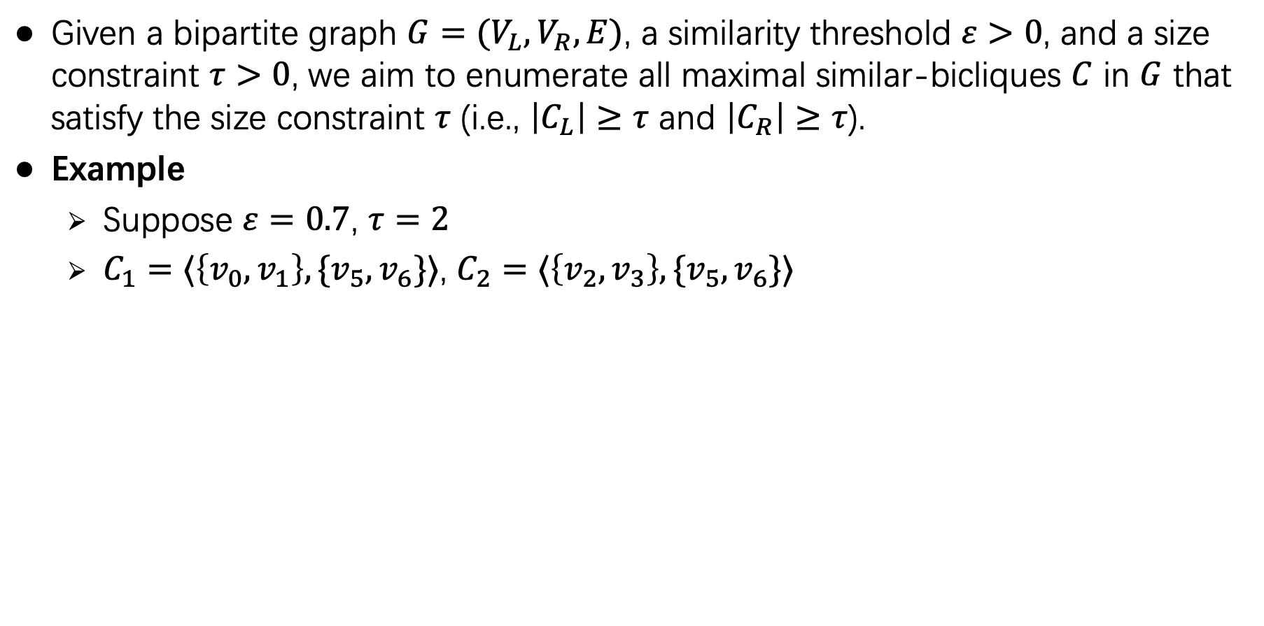
Problem statement
Given a bipartite graph $G=(V_{L},V_{R},E)$, a similarity threshold $ε>0$, and a size constraint $τ>0$, we aim to enumerate all maximal similar-bicliques $C$ in $G$ that satisfy the size constraint $τ$ (i.e., $\left|C_{L}\right|≥τ$ and $\left|C_{R}\right|≥τ$).
Example
Suppose $ε=0.7$, $τ=2$
$C_{1}=⟨\left\{v_{0},v_{1}\right\},\{v_{5},v_{6}\}⟩$, $C_{2}=⟨\left\{v_{2},v_{3}\right\},\{v_{5},v_{6}\}⟩$
A bipartite graph
Two maximal similar-bicliques

Slide 27
A baseline algorithm
Maximal similar-bicliques must be contained in maximal bicliques.
A baseline algorithm:
Enumerating all maximal bicliques by invoking state-of-the-art maximal biclique enumeration algorithm.
Post-process the detected maximal bicliques to obtain maximal similar-bicliques.
As observed in experiments, enumerating all maximal bicliques is already time-consuming.

Slide 28
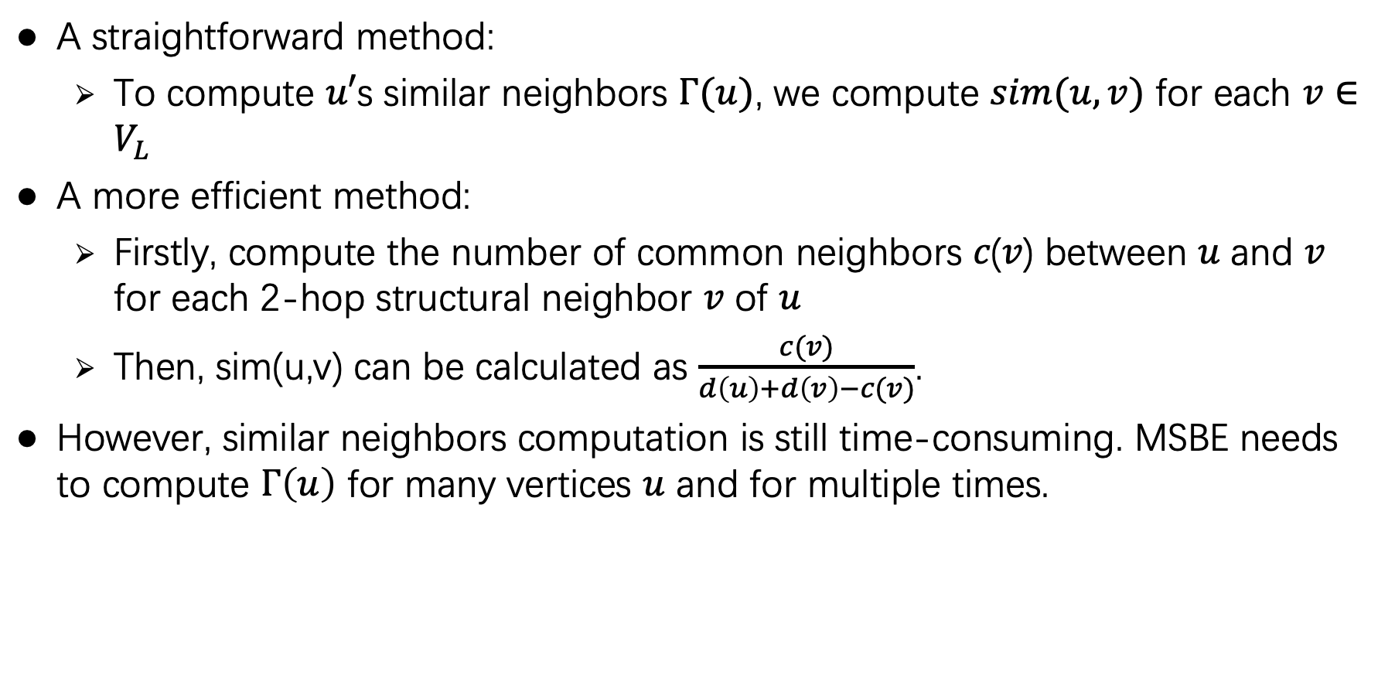
Similar neighbors computation
A straightforward method:
To compute $u′$s similar neighbors $Γ(u)$, we compute $sim(u,v)$ for each $v∈V_{L}$
A more efficient method:
Firstly, compute the number of common neighbors 𝑐(𝑣) between 𝑢 and 𝑣 for each 2-hop structural neighbor 𝑣 of 𝑢
Then, sim(u,v) can be calculated as $\frac{c(v)}{d\left(u\right)+d\left(v\right)−c(v)}$.
However, similar neighbors computation is still time-consuming. MSBE needs to compute $Γ\left(u\right)$ for many vertices $u$ and for multiple times.

Slide 29
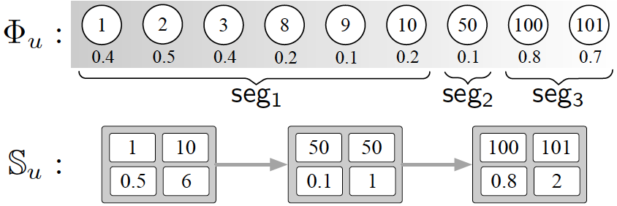
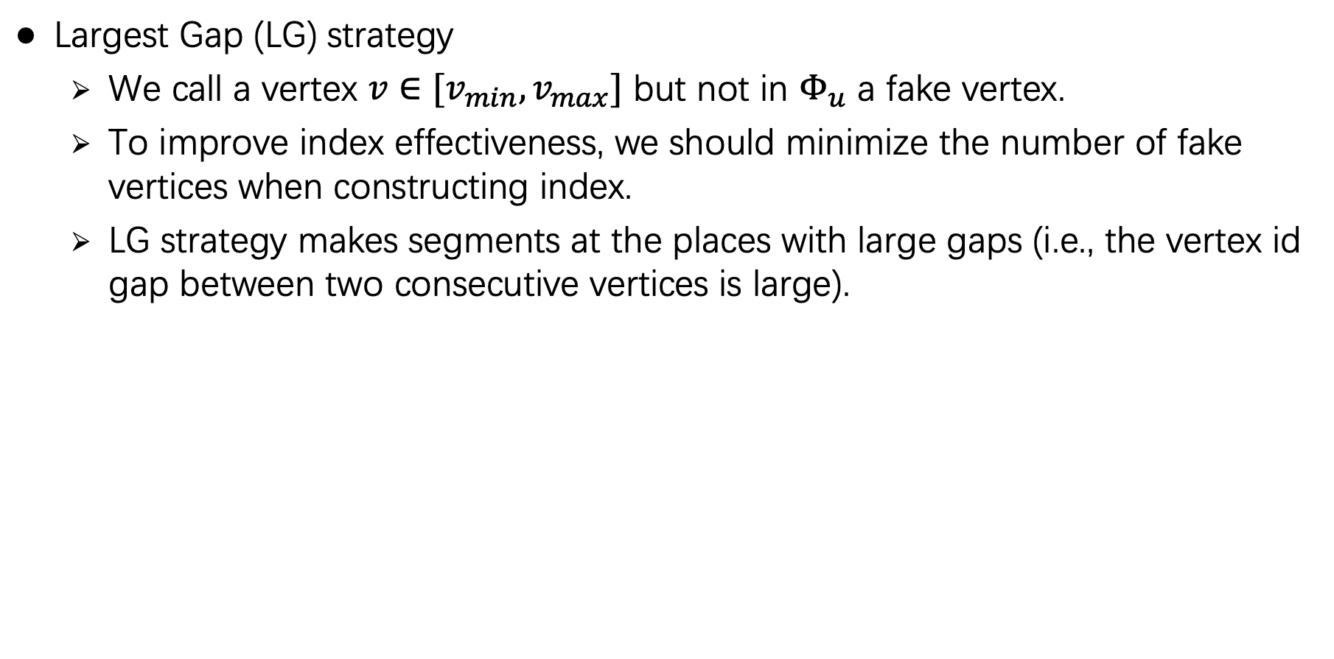
Different strategies to construct the index
Largest Gap (LG) strategy
We call a vertex $v∈[v_{min},v_{max}]$ but not in $Φ_{u}$ a fake vertex.
To improve index effectiveness, we should minimize the number of fake vertices when constructing index.
LG strategy makes segments at the places with large gaps (i.e., the vertex id gap between two consecutive vertices is large).
40
50

Slide 30
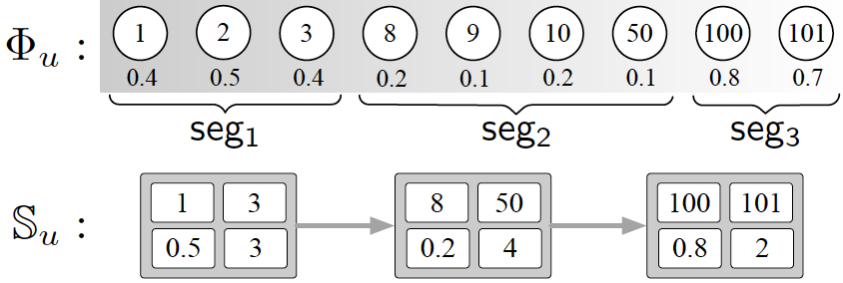
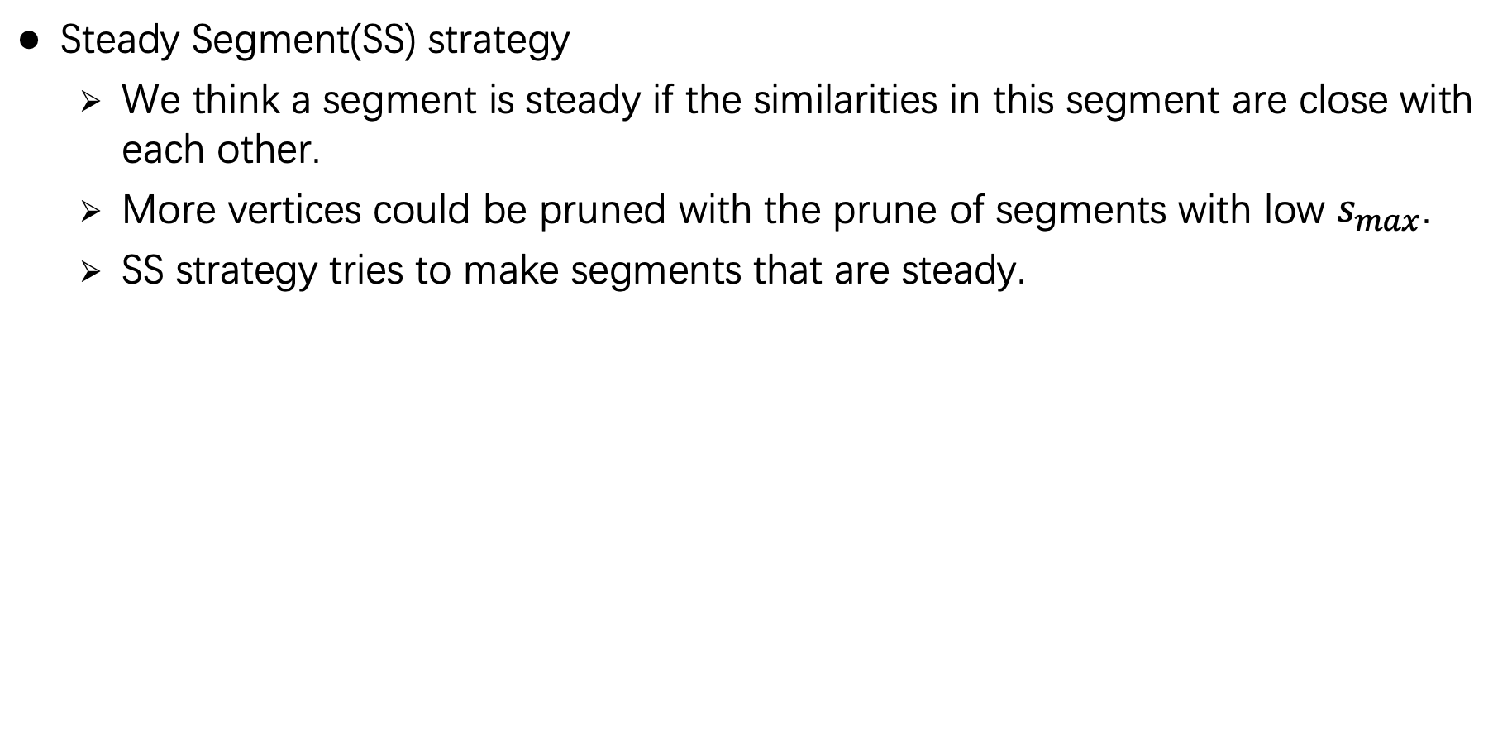
Different strategies to construct the index
Steady Segment(SS) strategy
We think a segment is steady if the similarities in this segment are close with each other.
More vertices could be pruned with the prune of segments with low $s_{max}$.
SS strategy tries to make segments that are steady.

Slide 31
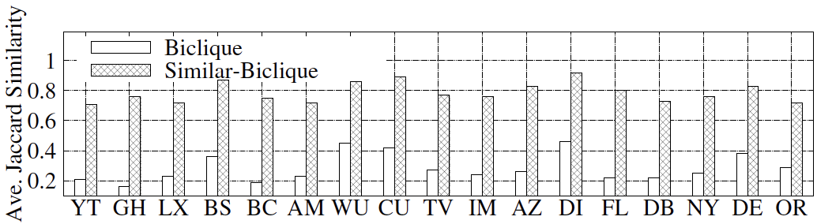
Effectiveness evaluation

